Slide 1
256-bit JPG Format Image Encryption Using Advanced Encryption Standard(AES) Implementation in Java Applet
Submitted by: Under the guidance of
Gourav Joshi (22MCA0286) Dr. Navaneethan C
(Associate Professor Senior-SITE)

Slide 2
Contents:
Problem Description
Literature Study
Implementation
Results
Conclusion
Future Work
References

Slide 3
Problem Description:
The rapid growth of digital communication and the increasing reliance on network-based data transmission have raised concerns about the security of sensitive information. As a result, there is a growing need for robust encryption techniques to ensure the confidentiality and integrity of data.
With the available encryption techniques, there lives malicious activates to steal or modify the data.
Traditional encryption techniques may not provide sufficient security for image data. To address this issue, there is a need to implement a robust encryption solution that can protect JPG format images effectively.

Slide 4
Literature Study:
[1] This paper proposes a technique combining 128-bit AES encryption, feature extraction, and random number generation for secure image data transmission. The system utilizes AES encryption in two levels and feature-based key generation to enhance confidentiality and security against attacks. However, the feature extraction process demands significant computational resources, impacting performance. Dual-level AES encryption may increase encryption time, delaying transmission. Poorly designed feature extraction algorithms may lead to weak keys exploitable by attackers. Additional storage for features and keys may raise implementation costs.
[2] This paper explores the usage of Data Encryption Standard (DES) for image encryption, along with the development of a Java-based DES encryption application. DES is a symmetric block cipher algorithm that ensures data confidentiality. However, DES requires an 8-byte or 8-character key length, and weaknesses such as third-party suspicions upon opening encrypted images and key leakage due to key reuse exist. These challenges emphasize the importance of stronger encryption methods and secure key management practices for improved security.
[3] This research proposes an enhanced AES algorithm for image encryption using an image as a key. The algorithm generates a state matrix and performs exclusive or sum operations with the key. This method improves security and performance compared to traditional key text methods. The use of image keys provides high-level security, but choosing an appropriate key image is a challenge. The application is for secure image encryption, offering high-level security and improved performance.

Slide 5
[4] The Advanced Encryption Standard (AES) and the logistic chaotic map are the foundations of the new method for picture encryption proposed in this study, called Dynamic AES. The proposed algorithm is tested against statistical and differential attacks and found to be superior to many other image encryption algorithms. The challenges may include implementation complexity, while the benefits include improved security. The application is secure transmission and storage of image data.
[5] This study presents a new picture encryption technique based on AES Key Expansion, offering high security with reduced processing resources. The encryption process involves bitwise exclusive OR between sets of picture pixels and unique 128-bit keys. Independent key generation using AES Key Expansion is performed at the sender and receiver sides. Evaluation using benchmark images shows its effectiveness. The algorithm requires less computational power, making it suitable for real-time image encryption in applications like video conferencing. However, key management can pose challenges, particularly in large-scale user applications.
[6] This paper presents the ECAT-AES-131 encryption technique for medical images, combining a pre-processing phase, modified Arnold Cat map, and AES-128 encryption. A comparative study with three algorithms and recent chaotic-based techniques demonstrates the proposed approach's robustness using medical imaging datasets. The results show enhanced encryption strength and image quality, with lower computational cost compared to AES and CAT-AES methods.

Slide 6
[7] This study presents a highly secure web-based authentication solution using image steganography and the 128-bit AES algorithm. The method pairs a facial identification photo as image with AES encryption, providing robust security. The proposed approach outperforms steganalysis attacks and is recommended for future online applications handling sensitive user information, addressing various security issues.
[8] This paper proposes a hybrid technique for efficient encryption and transmission of medical images over networks. The technique involves encrypting the region of interest (ROI) using AES, followed by lossless compression for transmission. Non-ROI regions are lossy compressed for higher compression ratios. At the receiving end, the ROI is decrypted and fused with the decompressed NON-ROI to reconstruct the original image. The paper provides related work, concepts, simulation results, and analysis of the proposed method.
[9] This paper explores the role of cryptography in network security, highlighting the importance of protecting data during transmission. It compares RSA and AES techniques for ensuring data integrity and discusses the hardware devices used in networking. The significance of data integrity in the medical field is emphasized. The proposed method compares RSA and AES, analysis simulation results, and concludes with implications for future research.
[10] This paper compares AES and RSA algorithms for digital image encryption, evaluating encryption quality, histogram readings, and correlation coefficient using MATLAB. The methodology involved encrypting and decrypting images with both algorithms and analysing the results. AES exhibited faster encryption and decryption times, while RSA showed better image quality and correlation coefficient. The study suggests that the choice of encryption algorithm should be based on user-specific requirements and preferences

Slide 7
Implementation
Algorithm Used:
The symmetric encryption method known as AES, or Advanced Encryption Standard, is one that is frequently employed to protect sensitive data.
AES can be used with keys that are 256 bits long and operates on fixed-size blocks of data. The same key is utilized in AES encryption for both encryption and decryption.
The algorithm is made up of numerous rounds of transformation that include Add round key, Sub Bytes, Shift Rows, Mixed Column etc.
These rounds make sure that the initial unencrypted data is properly jumbled and hidden, making it challenging for unauthorised parties to identify any patterns and recover the original data. AES uses key exchange for encryption.

Slide 8
Implementation:
steps to implement image encryption using AES in Java:
Import the required java libraries:
Load the image file into a byte array.
Generate a secret key(256 bit) for AES encryption.
Initialize the AES cipher with the secret key.
Encrypt the image data.
Save the encrypted data to a file.
To decrypt the image data, initialize the cipher in decrypt mode and use the same secret key.
Save the decrypted data to a file.

Slide 9
IDE & MODULES:
Ide: Visual Studio Code
Modules:
1. Input/Output Module: io, imageio
2. Encryption Module: crypto
3. User Interface Module: swing, awt

Slide 10
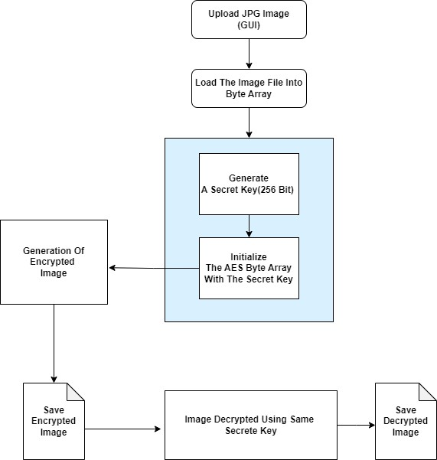
Project Flow Chart:

Slide 11
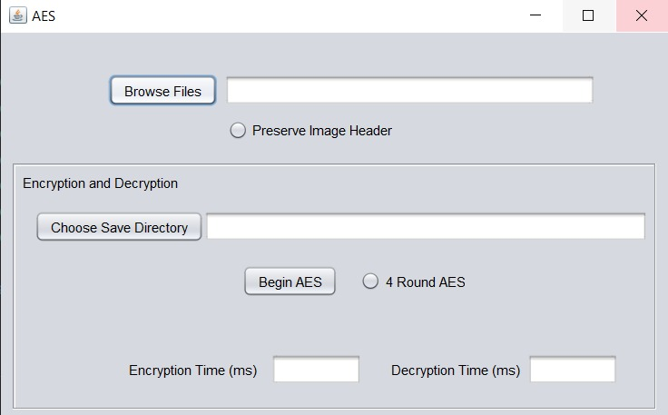
Results:
* GUI Main Window

Slide 12
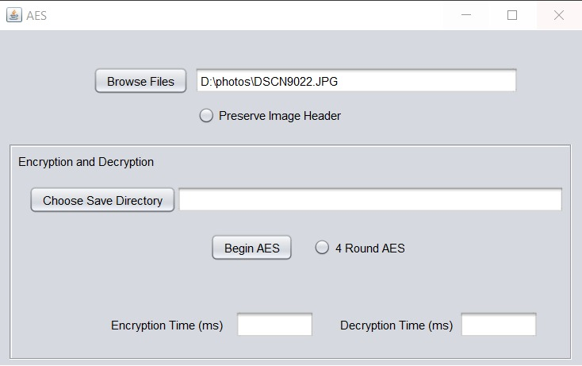
* User Choose Image File for Encryption

Slide 13
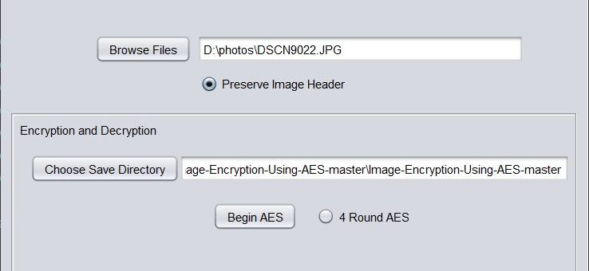
* User Choose Output File Name And Destination After Encryption

Slide 14
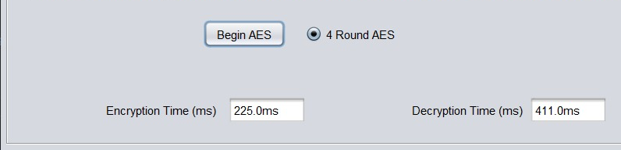
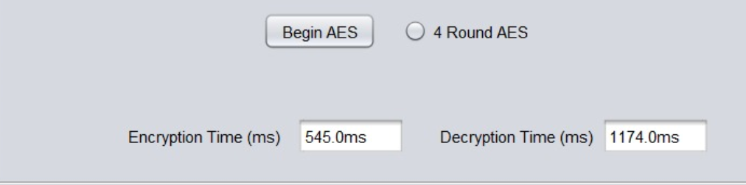
* User Can Choose Number of AES Round 4 or 14
Encryption Process 4 Round
Encryption Process 14 Round

Slide 15
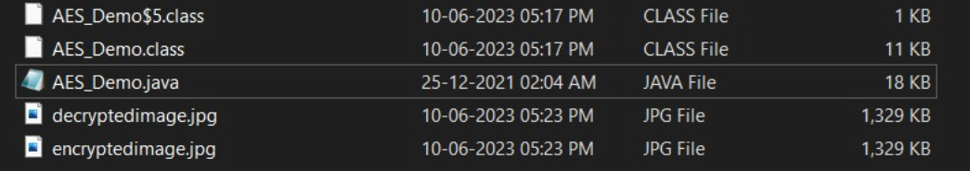

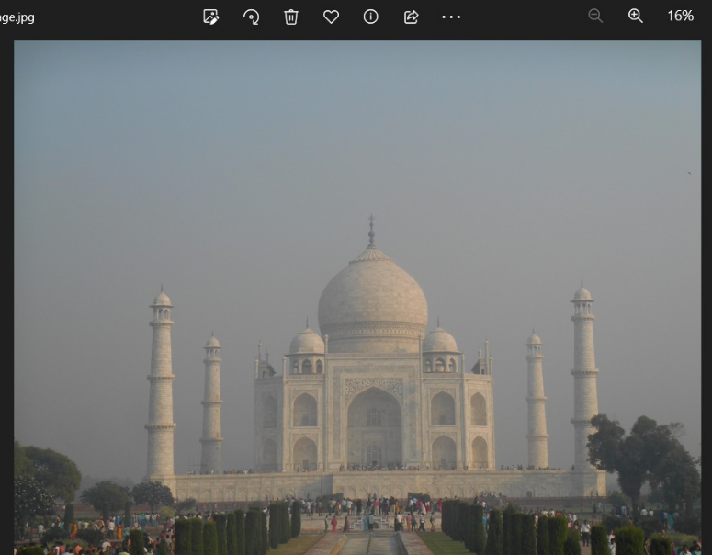
* Output:
Encrypted Image:
Decrypted Image:

Slide 16
Future Work
Using for other types of file formats like a pdf, audio file etc.
Add a user authentication for authenticate valid user.
Explore integrating image compression algorithms to reduce the size of the encrypted image without compromising the encryption strength. This can help optimize storage and transmission requirements while maintaining data security.
Enhance the key management module to incorporate secure key generation and exchange mechanisms, such as using key derivation functions or public-key cryptography, to strengthen the overall security of the encryption process.
Refine the user interface module by enhancing the usability, adding additional features like drag-and-drop functionality, and improving the visual feedback provided during the encryption process.

Slide 17
References
[1] Upadhyaya, Akanksha & Shokeen, Vinod & Srivastava, Garima. (2015). Image encryption: Using AES, feature extraction and random no. generation. 1-4. 10.1109/ICRITO.2015.7359286.
[2] Bastanta, Artha & Nuryansyah, Ramadhany & Nugroho, Christian & Budiharto, Widodo. (2021). Image Data Encryption Using DES Method. 130-135. 10.1109/ICCSAI53272.2021.9609738.
[3] Quenaya, M. R., Villa-Herrera, A. A., Chambi Ytusaca, S. F., Yauri Ituccayasi, J. E., Velazco-Paredes, Y., & Flores-Quispe, R. (2021). Image Encryption using an Image Pattern based on Advanced Encryption Standard. In C. E. Velasquez-Villada (Ed.), 2021 IEEE Colombian Conference on Communications and Computing, COLCOM 2021 [9486298]
[4] Shariatzadeh, Mahdi & Rostami, Mohamad & Eftekhari, Mahdi. (2021). Proposing a novel Dynamic AES for image encryption using a chaotic map key management approach. Optik. 246. 167779. 10.1016/j.ijleo.2021.167779.
[5] Zhang, Yong & Li, Xueqian & Hou, Wengang. (2017). A fast image encryption scheme based on AES. 624-628. 10.1109/ICIVC.2017.7984631.
[6] M. A. W. Shalaby, M. T. Saleh and H. N. Elmahdy, "Enhanced Arnold’s Cat Map-AES Encryption Technique for Medical Images," 2020 2nd Novel Intelligent and Leading Emerging Sciences Conference (NILES), Giza, Egypt, 2020, pp. 288-295, doi: 10.1109/NILES50944.2020.9257876.

Slide 18
[7] H. Mogale, M. Esiefarienrhe and L. Letlonkane, "Web Authentication Security Using Image Steganography and AES Encryption," 2018 International Conference on Intelligent and Innovative Computing Applications (ICONIC), Mon Tresor, Mauritius, 2018, pp. 1-7, doi: 10.1109/ICONIC.2018.8601208.
[8] A. A. A. Laimoon, M. M. A. Elnaby, A. H. Hussein and H. M. A. Kader, "Light Weight Encryption for Medical Images," 2016 26th International Conference on Computer Theory and Applications (ICCTA), Alexandria, Egypt, 2016, pp. 26-31, doi: 10.1109/ICCTA40200.2016.9512947.
[9] B. J. S. Kumar, V. K. Roshni Raj and A. Nair, "Comparative study on AES and RSA algorithm for medical images," 2017 International Conference on Communication and Signal Processing (ICCSP), Chennai, India, 2017, pp. 0501-0504, doi: 10.1109/ICCSP.2017.8286408
[10] D. M. Alsaffar et al., "Image Encryption Based on AES and RSA Algorithms," 2020 3rd International Conference on Computer Applications & Information Security (ICCAIS), Riyadh, Saudi Arabia, 2020, pp. 1-5, doi: 10.1109/ICCAIS48893.2020.9096809.

Slide 19
Thank you

